Slide 1
隨機1000000筆(10%)且只取葉綠素1.5 nn第一版

Slide 2
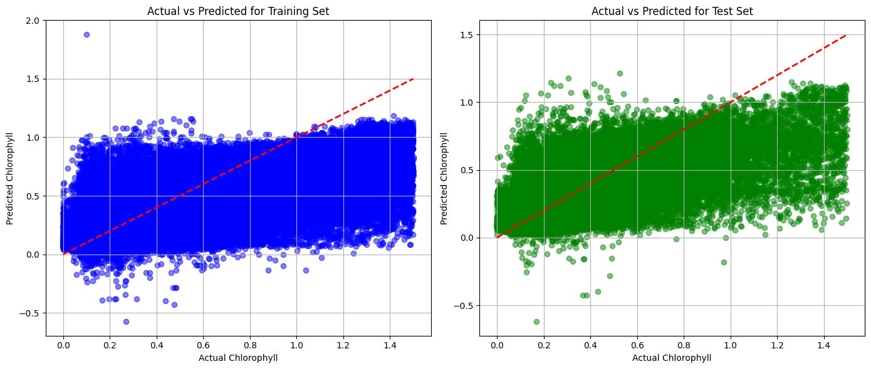
Alpha = 0.5

Slide 3
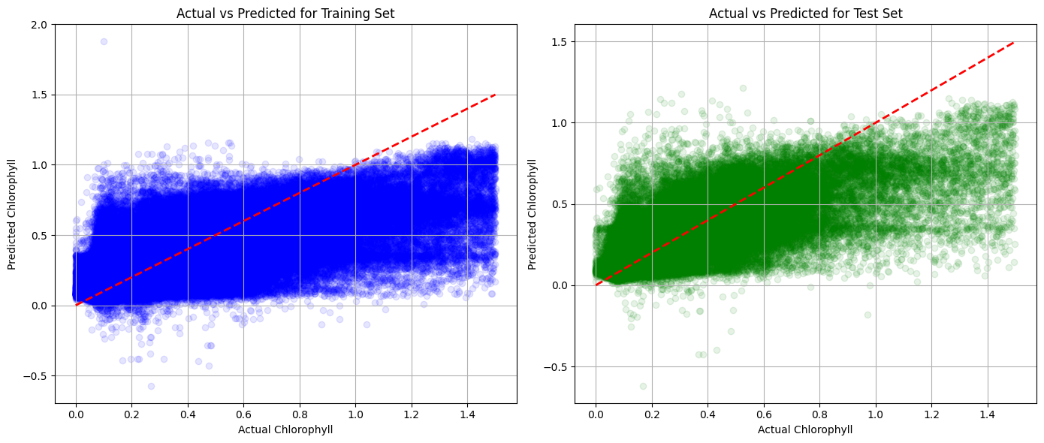
Alpha = 0.1

Slide 4
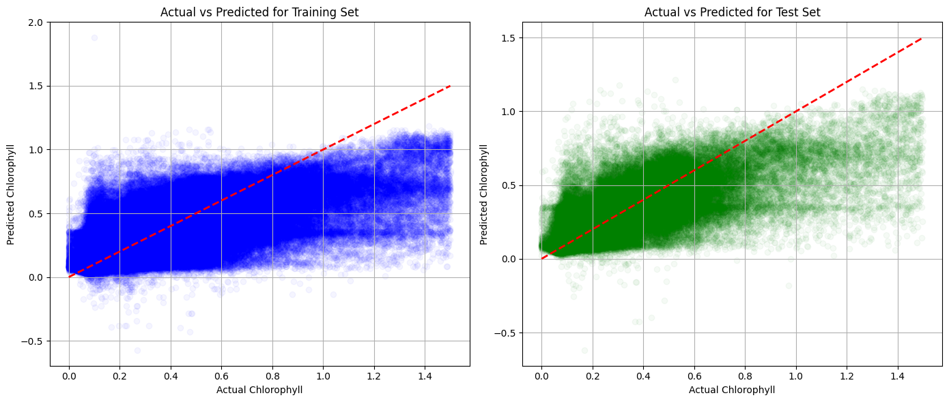
Alpha = 0.04

Slide 5
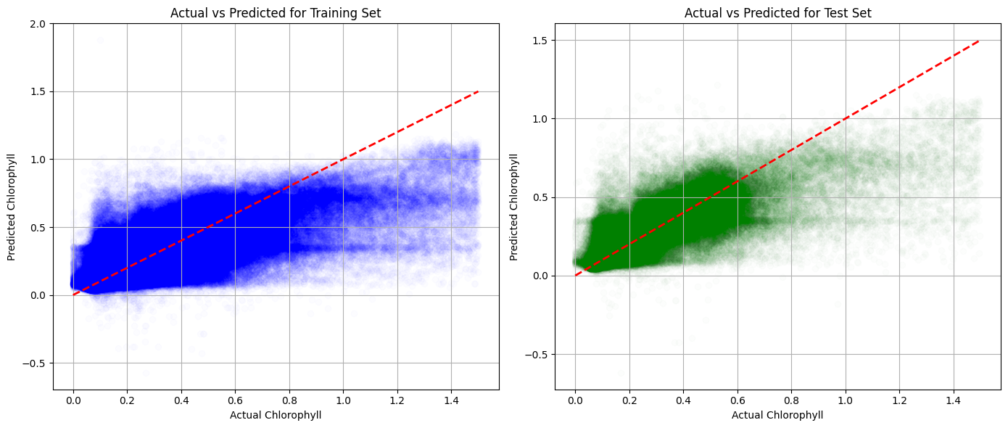
Alpha = 0.01

Slide 6
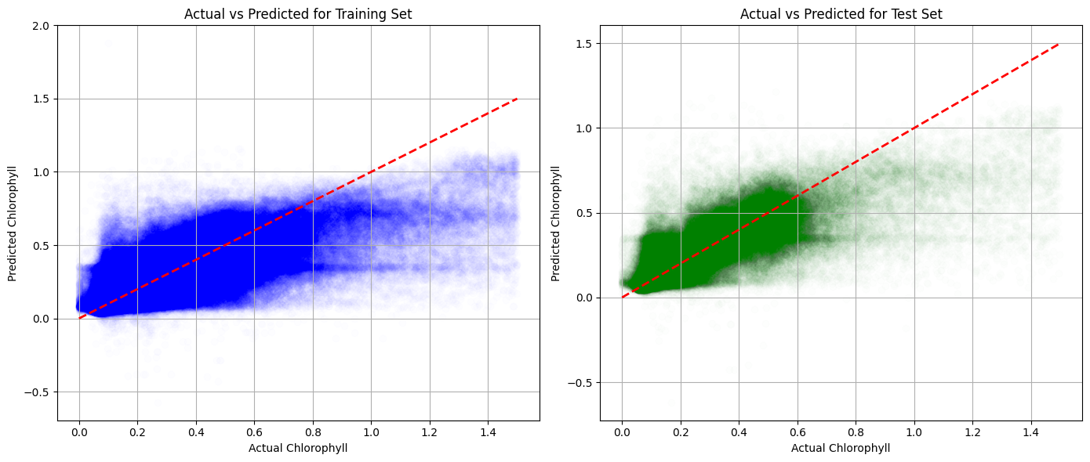
Alpha = 0.008

Slide 7
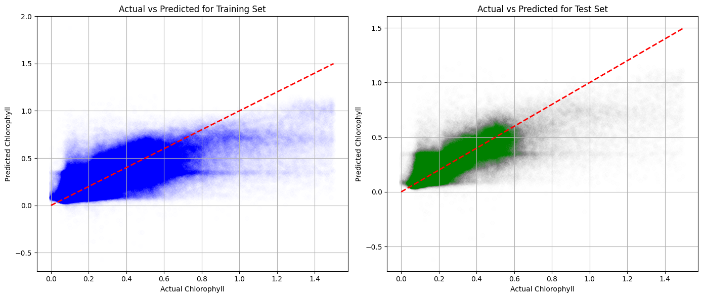
Alpha = 0.004

Slide 8
Alpha = 0.002

Slide 9
隨機1000000筆(10%)且只取葉綠素3 nn第二版

Slide 10
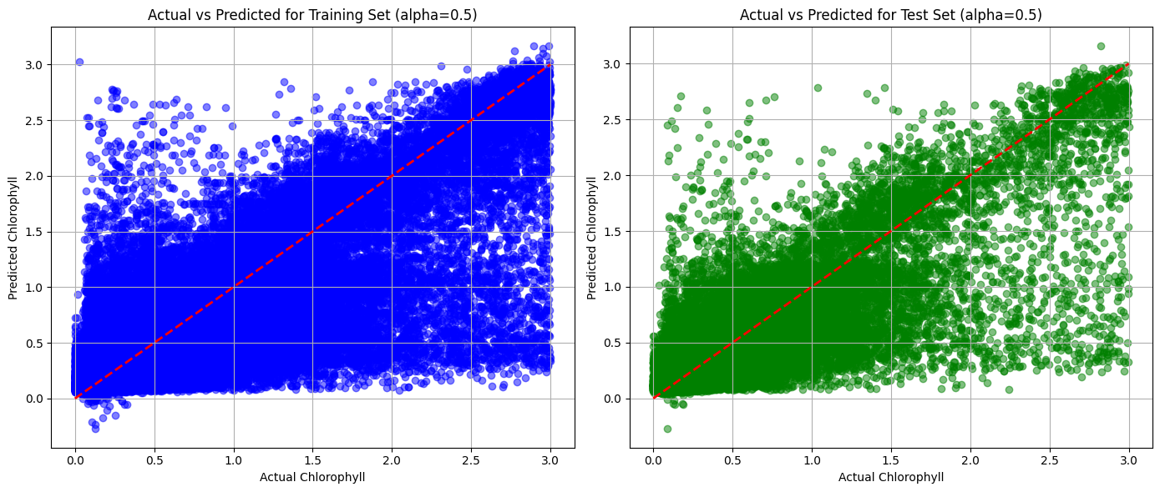
Alpha = 0.5

Slide 11
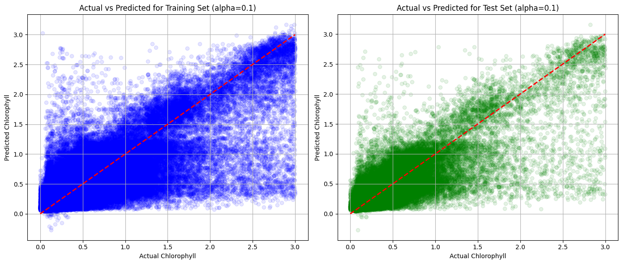
Alpha = 0.1

Slide 12
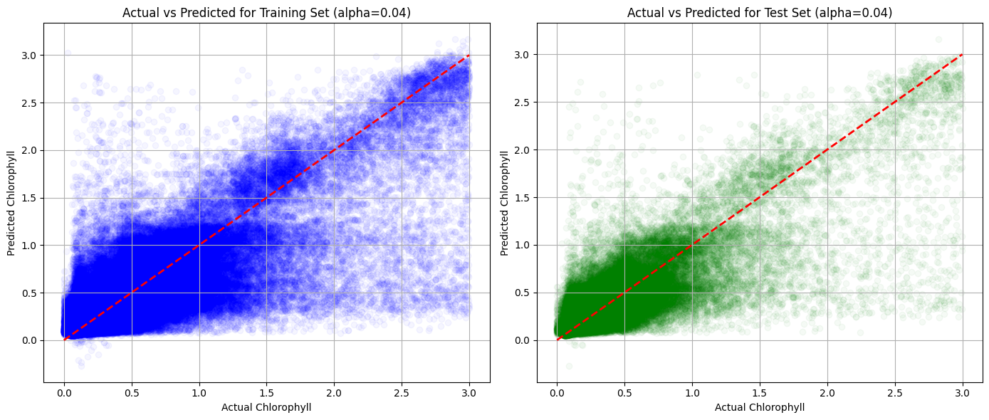
Alpha = 0.04

Slide 13
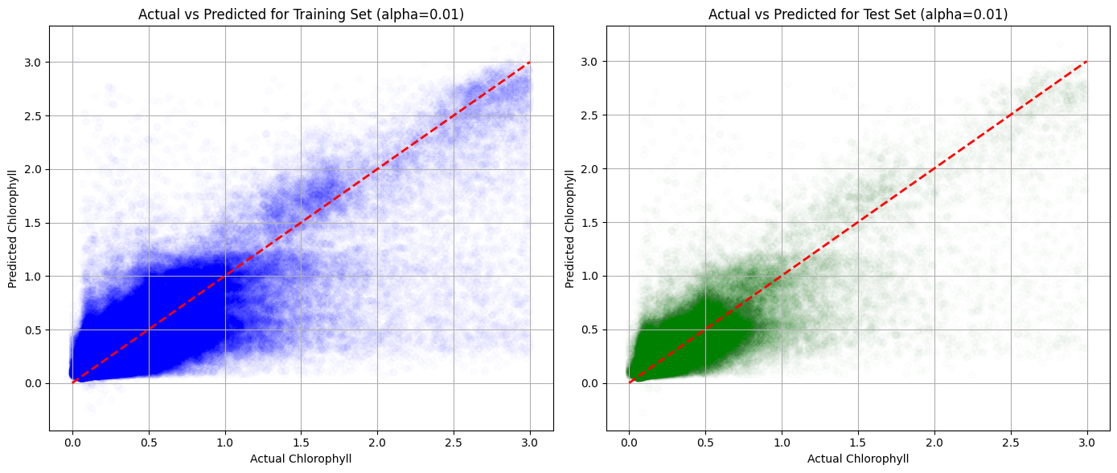
Alpha = 0.01

Slide 14
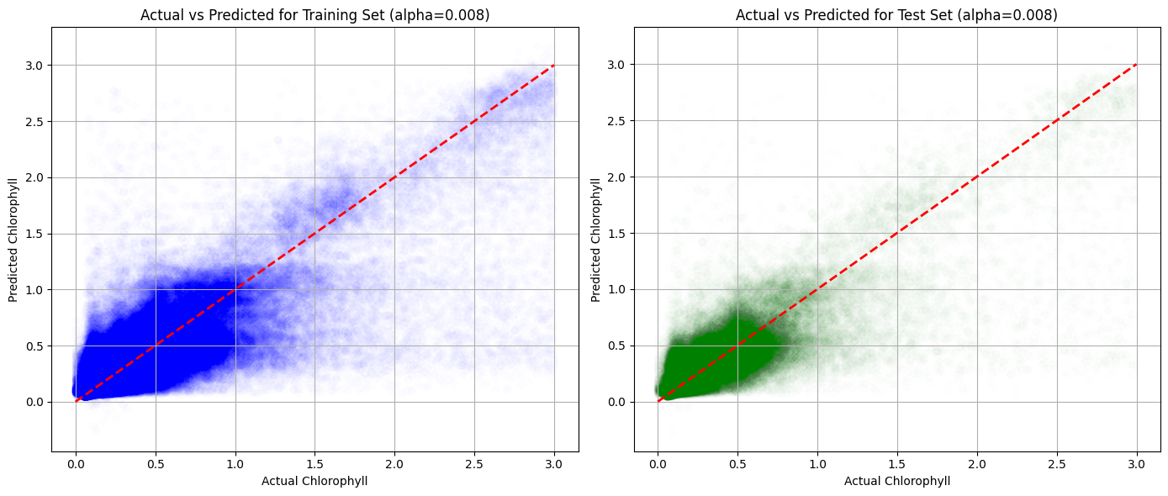
Alpha = 0.008

Slide 15
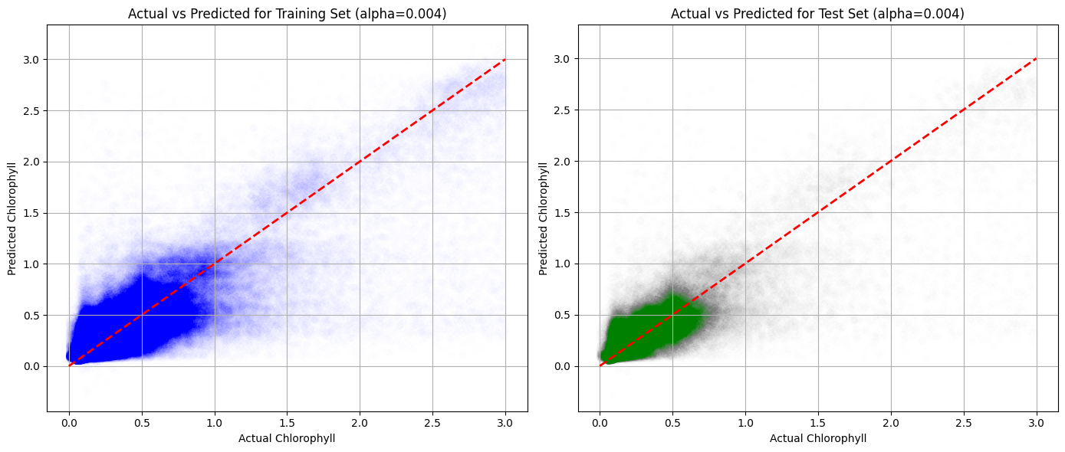
Alpha = 0.004

Slide 16

Alpha = 0.002

